Slide 1

Know The Science Behind WorkFlows
Using Git and GitHub

Slide 2
Objectives
At the end of the session you will know
Overview of Version Control and Git
Introduction to GitHub
What are Git branches and Use cases
How Workflows help and Use cases
Introduction of Tools like GitHub Desktop for Code Reviews

Slide 3
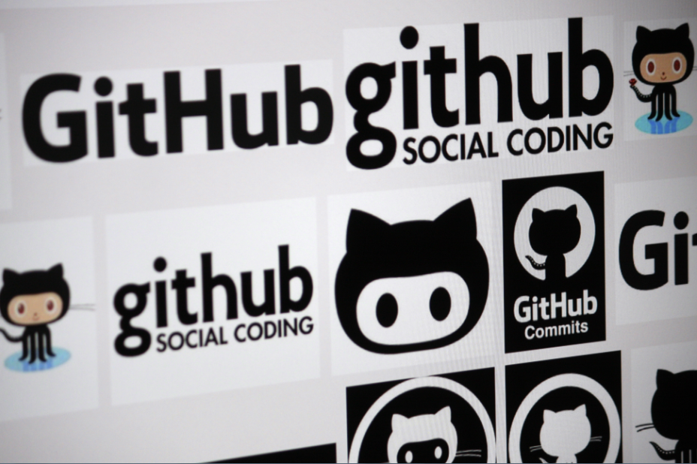

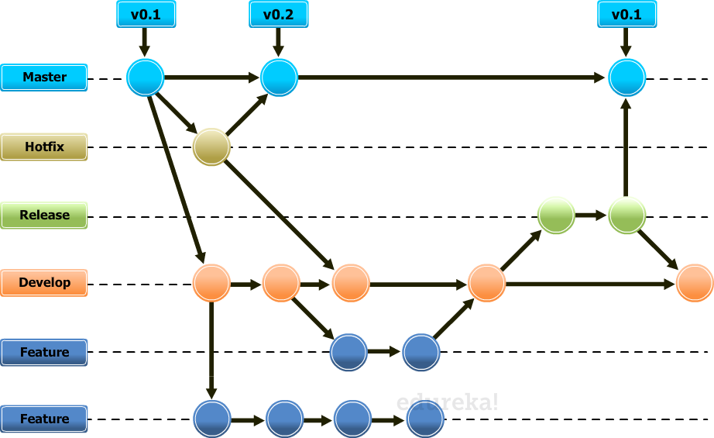
Introduction to Git
Work
Flows

Slide 4
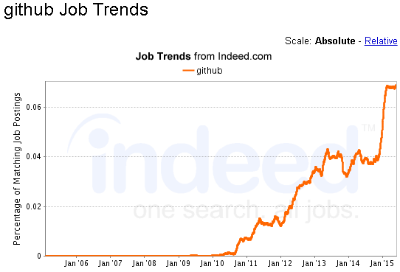
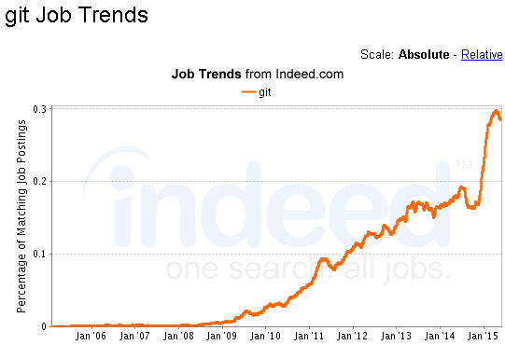
Job Trends
Git & GitHub are having high demand in the Industry

Slide 5
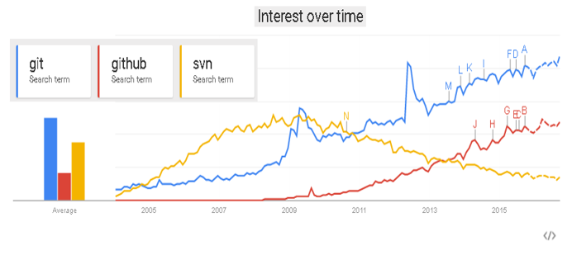
Google Trends Comparison
Search volume on Google

Slide 6

Version Control and Git
Keep every version of your file
It allows you to revert files back to a previous state
Revert the entire project back to a previous state
Compare changes over time
See who last modified something that might be causing a problem
Who introduced an issue and when.
If you lose files, you can easily recover.

Slide 7
What is Git?
Git is a Distributed revision control system
Speed, Data integrity and support for distributed, non-linear workflows.
Git was initially designed and developed for Linux kernel development in 2005
With Git, nearly all operations are performed locally, giving it a huge speed advantage on centralized systems that constantly have to communicate with a server somewhere.
Git effectively handles large repositories. Speed and performance have been its primary design goal.
The size of the data on the client side is very similar even though Git also has every version of every file for the entire history of the project.

Slide 8

Git Features
Free Distributed version control systems
Every Git working directory is a full-fledged repository with complete history
Full version-tracking capabilities
Independent of network access or a central server
Fast performance and Scalable
Rich command set that provides both high-level operations and full access to internals

Slide 9

Use Case - Role Based Code Lines
Have a branch that always contains only what goes to production
Another that you merge work into for testing
And several smaller ones for day to day work

Slide 10
Use Case - Feature Based Workflow
Create new branches for each new feature you're working on so you can seamlessly switch back and forth between them.
Then you can delete each branch when that feature gets merged into your main line.

Slide 11

Use Case - Parallel

Slide 12

Use Case - Independent

Slide 13

Use Case - Dummy projects
Frictionless Context Switching. Create a branch to try out an idea, commit a few times, switch back to where you branched from, apply a patch, switch back to where you are experimenting, and merge it in.

Slide 14

Use Case - Release blocks work on Main branch

Slide 15
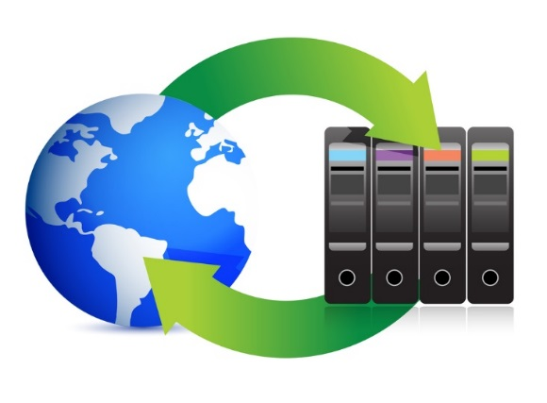
Use Case - Repository
Repository – Needed for backup, restore and fault tolerant

Slide 16

Use Case - Take your time

Slide 17

Use Case - Offline

Slide 18

Use Case - Testing

Slide 19

Use Case - Training

Slide 20
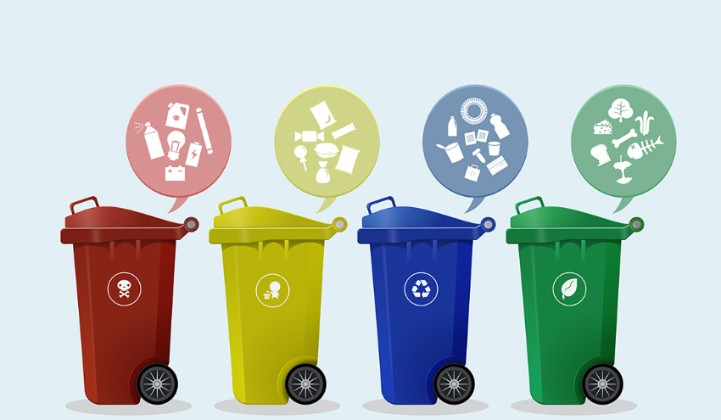
Use Case - Inexpensive to Discard
Disposable Experimentation. Create a branch to experiment in, realize it's not going to work, and just delete it -abandoning the work—with nobody else ever seeing it (even if you've pushed other branches in the meantime).

Slide 21
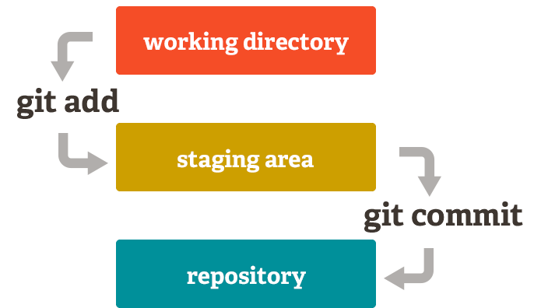
Git Staging Area

Slide 22
What is Github
GitHub is a Web-based Git repository hosting service
Distributed revision control and source code management (SCM) functionality
Web-based graphical interface and desktop as well as mobile Integration, Access control
Collaboration features such as bug tracking, feature requests, task management, and wikis for every project

Slide 23


GitHub Flows

Slide 24

GitHub Branches

Slide 26
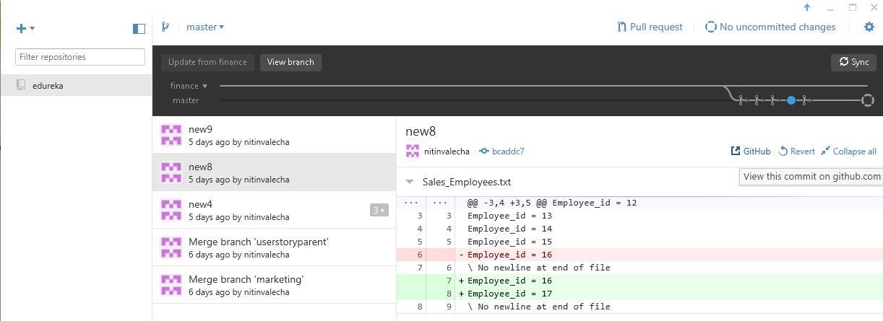
Code review on GitHub Desktop

Slide 27
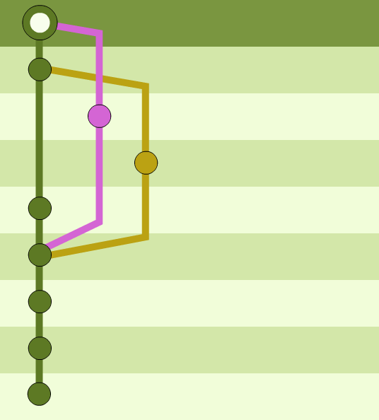
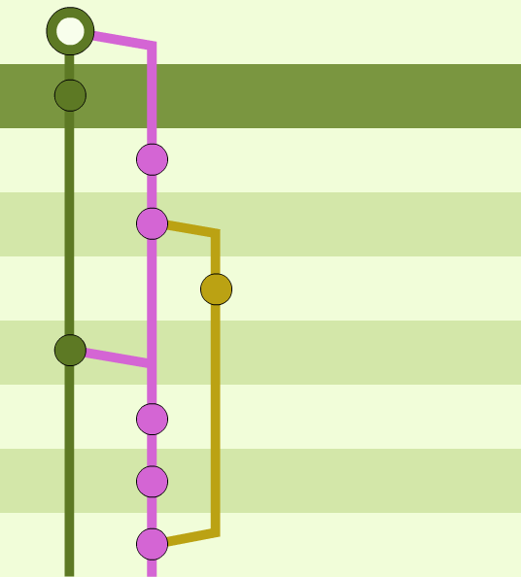
Branch Diagram

Slide 28
GitFlow WorkFlow

